Slide 1
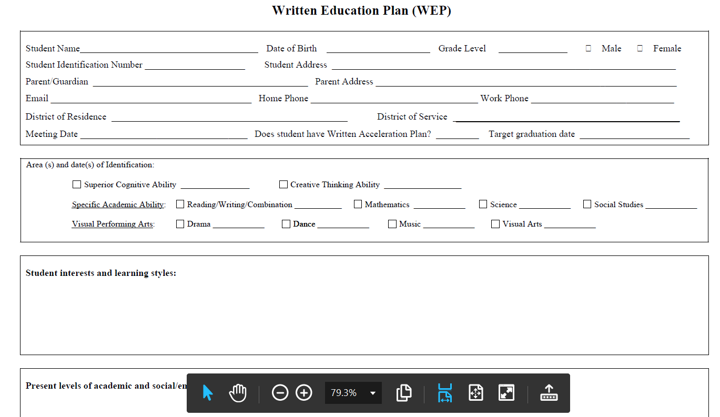
A written plan is essential for intentional planning.
We all face “round tuit” syndrome.
Communication among stakeholders is tough.
Stakeholders have different ideas about what works.
Signatures signal agreement.
[use this space to place an image that best captures the main idea of point #1]
Tip: The font type and size used in a PowerPoint presentation should be clear enough and large enough for the audience to easily see and read. Be sure to keep in mind the distance between the audience and the presentation screen.
Notes:
I put a date on my calendar to create a plan or plans.
I schedule a meeting with stakeholders - could be parent conferences, could be a Teacher Based Team meeting, could be Friday lunch (the psychs and I liked Telaquepaque) to discuss the needs of the learner or learners.
Frame some questions about the learner - what are the different perspectives on what works for the student? (Parents live with these kids.) Give people an idea of what you think could be a good goal for the student or students (accelerated reading materials, Algebra 1 class for 7th graders, an in-depth project on the importance of civil discourse).
How are you going to know who really has “buy in”? A signature signifies who’s on board.
Now on to the nuts and bolts - not always best to build the plane as you’re flying it.

Slide 2
This is the SMART goal for a gifted student in my class.
Annual Goal:
Student will demonstrate (content, process or product)
_________________________________________
Within this time frame _______________________
By (action)
_________________________________________
And we will know he/she accomplished this by
(evaluation tool for content, process or product)
_________________________________________
Tip: If time and format permits it may be a good idea to add another slide for questions. It may be as simple as a title that states “Questions?”
Notes:
Ohio and Colorado have excellent documents (WEPS and ALPS) that are truly detailed and robust SMART goals. They address levels of academic functioning, social and emotional considerations, as well as services outside the classroom that can be accessed.

