Slide 1
Do Honors Students Study More? Exploring Patterns of Time Use for Honors College Students
Angie L. Miller, Ph.D.
Center for Postsecondary Research
Indiana University Bloomington

Slide 2
INTRODUCTION
Many models in gifted education that address origins, development, and functioning include an environmental component
Important to look at role of “nurture”
Also important to look at the effectiveness of these models across all ages

Slide 3
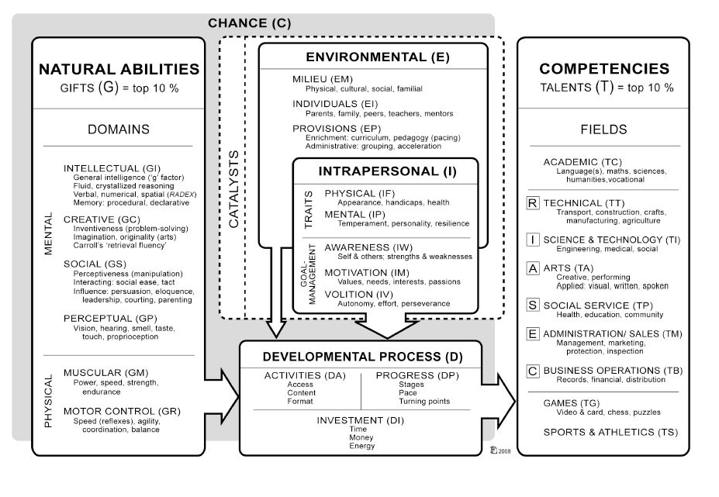
INTRODUCTION
DMGT (Gagné, 2009)

Slide 4
HONORS COLLEGES
Many variations in organization and implementation
Admissions criteria, starting status, curricular requirements, living options
Basic common components in majority of Honors Colleges/programs:
Special versions of gen. ed. courses, small class size, advanced courses (colloquia, seminars)
Many also feature:
Interdisciplinary courses; final thesis, capstone, creative project; special residence halls or study rooms

Slide 5
THE COLLEGE EXPERIENCE
National Survey of Student Engagement (NSSE)
NSSE gives a snapshot of college student experiences in and outside of the classroom by surveying first-year and senior students
NSSE items represent good practices related to desirable college outcomes
Indirect, process measures of student learning and development

Slide 6
NSSE “TIME ON TASK” ITEMS
Preparing for class (studying, reading, writing, doing homework or lab work, analyzing data, rehearsing, and other academic activities)
Participating in co-curricular activities (organizations, campus publications, student government, fraternity or sorority, intercollegiate or intramural sports, etc.)
Working for pay on campus
Working for pay off campus
Doing community service or volunteer work
Relaxing and socializing (time with friends, video games, TV or videos, keeping up with friends online, etc.)
Response options: 0, 1-5, 6-10, 11-15, 16-20, 21-25, 26-30, More than 30 (Hours per week)
Notes:
About how many hours do you spend in a typical 7-day week doing the following?

Slide 7
PURPOSE
This study extends research on the experience of specialized programming and curriculum for gifted individuals to those at the college level
Given potential requirements of honors curricula (independent research, internships, service learning, and study abroad) one might expect honors college students to allot more time to studying, in turn sacrificing time for other types of (nonacademic) activities
Are there differences in patterns of time use for honors students for various types of activities, even after controlling for other demographic and institutional characteristics?

Slide 8
DATA SOURCE
National Survey of Student Engagement (NSSE)
In 2017, more than 380,000 first-year and senior respondents from 636 four-year colleges and universities
Reasons for participation vary:
National and regional accreditation
Departmental/program reviews
Curricular reform (general education)
Institutional improvement efforts (e.g., retention rates, high-impact practices, FYE programming)
Notes:
NSSE annually gathers valid, reliable information on the extent to which students engage in and are exposed to proven educational practices that correspond to desirable learning outcomes.
Ask students about their experiences
Focuses on behaviors and perceptions of institutional support

Slide 9
SAMPLE
Limited to:
27 four-year institutions
First-year and senior students (n=8,672)
Experimental item set with additional items appended to core survey
 | Valid %
First-generation | 53%
Traditionally-aged | 73%
Female | 64%
Race/ethnicity
Asian, Asian American | 4%
Black, African American | 20%
Latino, Hispanic | 12%
White | 51%
 | # of institutions
Private | 13
Size
<2,500 | 13
2,500-4,999 | 3
5,000-9,999 | 9
>10,000 | 2
Carnegie type
Research/Doc | 4
Master’s | 13
Bac. colleges | 9

Slide 10
HONORS COLLEGE ITEM
Are you currently in an honors program or honors college at your institution?*
No
Yes
Not applicable, to my knowledge my institution does not have an honors program or college**
*Those who responded “Yes” were recoded to create a dichotomous “Honors participant” flag (21% of respondents)
**Schools with high percentages of “not applicable” were researched to verify existence of honors programs, and dropped if no evidence was found

Slide 11
METHODS
OLS regression models (12 total)
Six relevant “time on task” items as DVs
Separate models for FY and SR
Controlling for student and institutional characteristics known to relate to the college student experience
All categorical variables were dummy-coded
Effect coding was used for categorical variables (instead of referent group)

Slide 12
OLS Independent Variables
Student demographics
College experiences
Sexual orientation
First-generation
Age
Gender identity
Race/Ethnicity
Educational aspirations
Disability status
International status
Enrollment status
Took all courses online
Major field
College grades
Transfer student
Living on campus
Institutional context
Control
Institution size
Carnegie classification
*Honors College participation
Notes:
All categorical variables were dummy-coded

Slide 13
RESULTS: FIRST-YEAR MODELS
 | First-Year
DV | Adj. R² | β
Preparing for class | .058*** | -.006
Participating in co-curricular activities | .069*** | .033
Working for pay on campus | .025*** | .065***
Working for pay off campus | .277*** | .011
Doing community service or volunteer work | .046*** | .057**
Relaxing and socializing | .056*** | .023
*p < .05, **p < .01, ***p < .001

Slide 14
RESULTS: SENIOR MODELS
 | First-Year
DV | Adj. R² | β
Preparing for class | .075*** | .020
Participating in co-curricular activities | .138*** | .030*
Working for pay on campus | .084*** | .029*
Working for pay off campus | .255*** | .008
Doing community service or volunteer work | .040*** | .052***
Relaxing and socializing | .078*** | -.005
*p < .05, **p < .01, ***p < .001

Slide 15
DISCUSSION
Honors college participation was a positive predictor of several types of time use:
Participating in co-curricular activities (SR only)
Working for pay on campus (FY and SR)
Doing community service/volunteer work (FY and SR)
Honors college participation did not predict time spent preparing for class, working for pay off campus, or relaxing and socializing

Slide 16
DISCUSSION
So how are honors students spending their time? Does this reflect expected curricular and programming requirements?
Not spending every moment studying, nor are they spending all of their time partying
No difference between honors and general education students on these activities after controlling for other variables
Participation in honors should not be a deterrent to those worried about “all work and no play”

Slide 17
DISCUSSION
So how are honors students spending their time? Does this reflect expected curricular and programming requirements?
More time on co-curricular activities and working on campus could be due to sense of community integration and encouragement for involvement
More time on community service and volunteer work also reflects programming for many honors colleges
Differences (or lack of) might also be due to better time management skills overall for honors students

Slide 18
LIMITATIONS
Honors college students are high achieving, which is not exactly the same as gifted
Research with K-12 populations may not always transfer
Self-reported data, time estimates
Self-selection: for institutions and students
Low explained variance and small effect sizes
Correlational, not causal design

Slide 19
FUTURE RESEARCH
Follow up on time management skills and strategies
Institution-level variance?
Other constructs of potential influence (e.g. achievement goal orientation and personality traits)
Link to other experiences and outcomes: high-impact practice participation, career plans
Other suggestions?

Slide 20
Questions & Comments?
Angie L. Miller
anglmill@indiana.edu

