Slide 1

The power of parents in entering primary school levels
Education for
(gifted) children at “het talent”

Slide 2
Determine the starting level…
Parents, childcare, preschool fill out this questionnaire at the age of 3.8
They make statements about the different developmental areas of the child
An intake at the school takes place, talking about the statements and giving examples by the parents
The child starts in school at the level parents indicated at the intake and the questionnaire
After 2 months at school, the mentor (teacher) fills out the questionnaire and has a conversation about the child with the parents

Slide 3
Entry characteristic questionnaire

Slide 4
The school “het talent”
Almost all Dutch children enter preschool at the age of 4. The focus is on play, social activities and educational materials relevant to their development and learning. Most Dutch schools have aged based groups for 8 years, there will be children in these groups that perform above average or below.
At “het talent” there are no age-based groups, children start at their own level and develop themselves at their own pace and educational needs
Working in units (little schools within the school), 640 children in 5 regular units and 1 fulltime gifted education unit
Teachers create different types of small instruction groups of children to help them at educational, social, motorial and emotional needs
Opportunities for children at risk at the bottom, and at the top. Pull-out classes for both (not together) and a fulltime unit for gifted children.

Slide 5
The Pedagogical - didactic kernel structure
Entry characteristic questionnaire
Offer of optional activities and structured (play) learning material lines
Monitoring of the progress on individual lines
Evaluate the effects

Slide 6
Portfolio, evaluation
Spil 20 is the end-level of grade 4, spil 21 is the beginning-level of grade 5

Slide 7
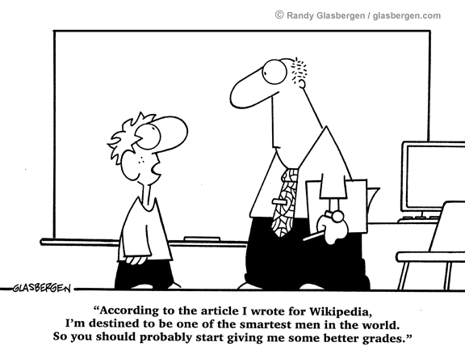
The first step
Unconditianable aknowledgement of the giftedness
Meeting like-minded peers
Offering adequate activities and instructions to these children
Involve experts
A coordinator who keeps an overview

Slide 8
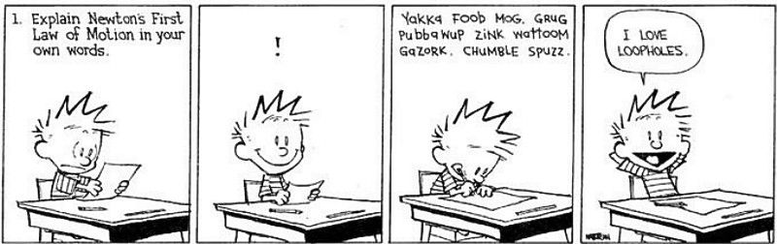
Identification of gifted children in our school
Do’s
  Entry characteristics questionaire
  Giftedness acknowledged by parents and/or teachers
  Observations by teachers
Don’ts (or only a bit…)
  Test results (scoring A’s)
  Proper written assignments
  Positive school attitude

Slide 9
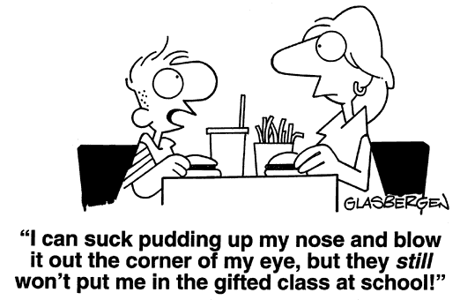
Identified ; and then….
Aknowledgement
  Name and talk about what being gifted means
Suitable education
  Cognitive challenging, learn to go off the beaten track
  Meeting peers
  Using experts
  Top Down instruction

Slide 10
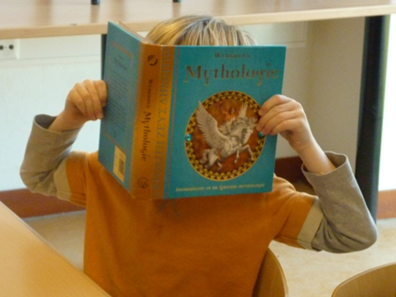
Full-time, pull-out or regular unit?
Choices are Full-time, pull-out, regular unit with extra’s
Depending on the child
In great need of like-minded peers
In need of a different way of instruction
Social-emotional reasons
Learning to learn
Dare to make mistakes

Slide 11
teaching in fulltime gifted education

Slide 12
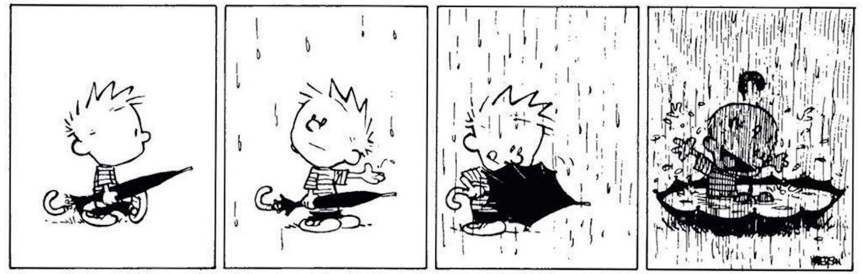
Cognitive challenge
skills
  Critical thinking
  Analythical thinking
  Creative thinking– out of the box
  The courage to discuss your own beliefs
On offer
  Experts
  In depth assignments
  Diversity
  Bilanguale education (fulltime education)

Slide 13
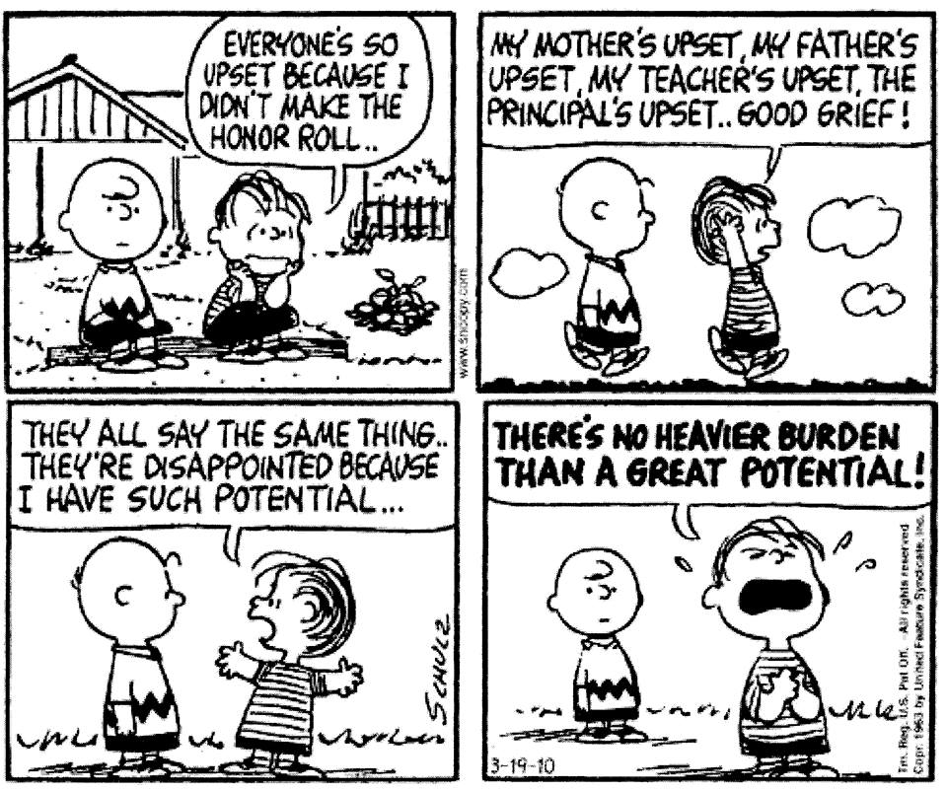
Get a grip on yourself
Implicit and explicit paying attention to;
  Feeling of justice
  Frustration tolerance
  Emotion regulation
  Planning and organisation
  Build a realistic self-image
  Dare making mistakes
  Functioning in a group

Slide 14
Portfolio pull-out class

Slide 15
Children have equal chances if they have unequal education

Slide 16
Want to know more?
Email me, or look at one of these articles or websites…
ingeborg@veldman.org
Screening children’s entry characteristics in kindergarten, T. Mooij, 2000
www.het-talent.nl
https://en.wikipedia.org/wiki/Technasium
https://montessoricollege.nl/onze-school-2/agora-onderwijs/agora-education/

