Slide 1
Great Expectations But Misunderstood
Tiffany Blassingame, Director of Academics
Ashley Scott, Student Development Coordinator
Midtown International School

Slide 2
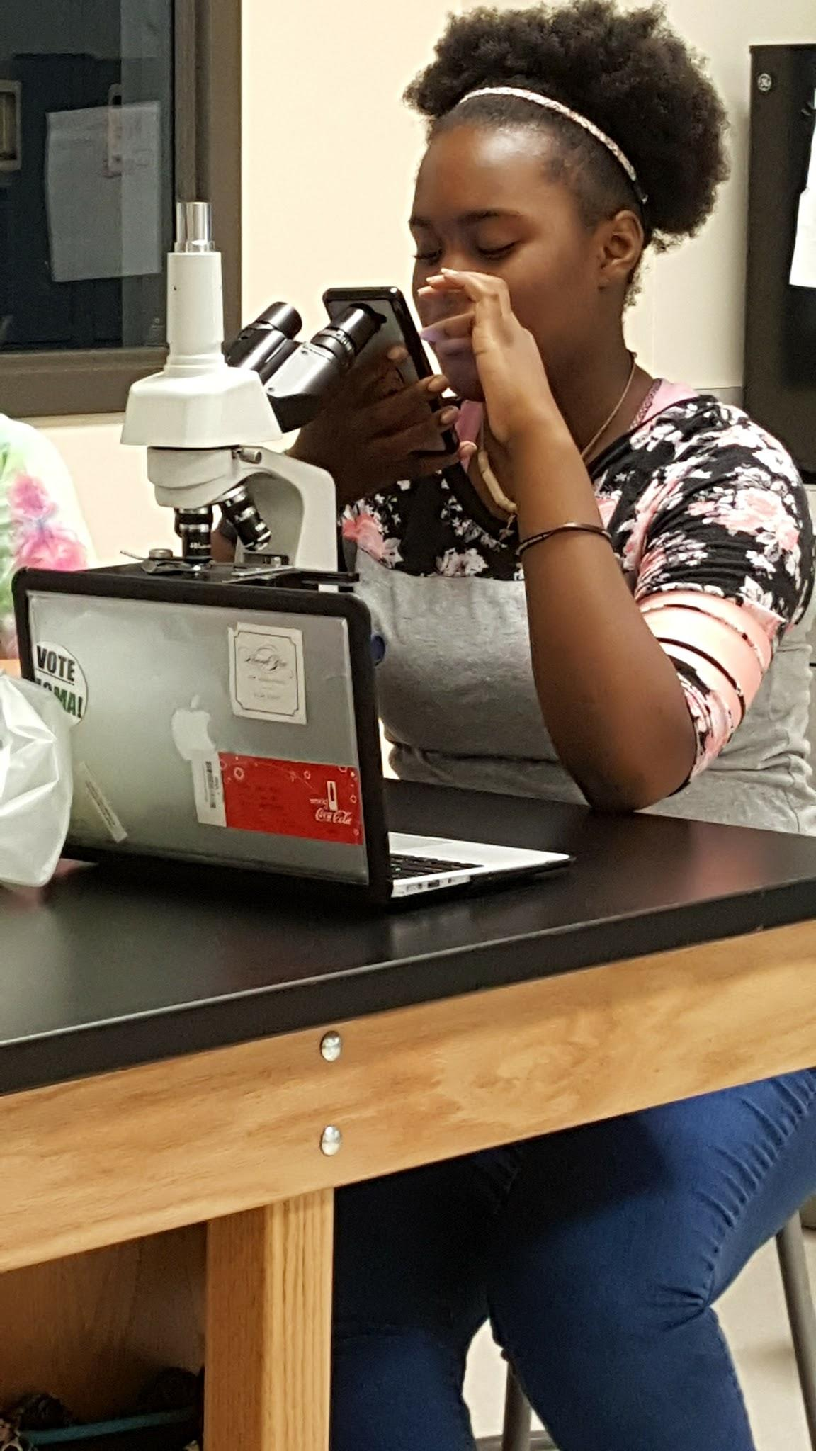
Gifted Child Characteristics
Can get “lost in thought”
Lack situational awareness
Deep thinkers
Move quickly through content
Intensities (OEs)
Work best in certain environments
Perfectionist
All or nothing
Black/White thinking
Notes:
Not more likely to have EF weakness compared to general population

Slide 3
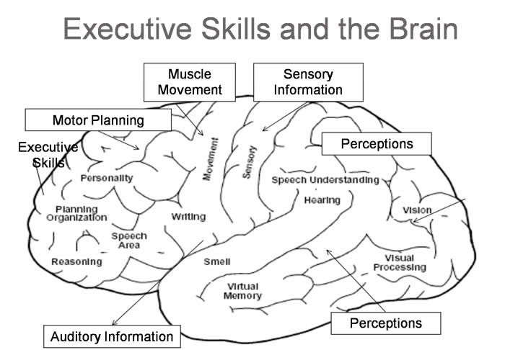
Executive Function System
Your child’s “Conductor” : helps join together many cognitive functions
Control center for
demonstrating awareness,
using prediction (recall),
generating a plan,
initiating appropriate action,
monitoring action and modifying as needed,
shifting flexibly between actions
Notes:
Frontal lobe

Slide 4
3 Key Items to Remember
They won’t be great at everything.
You are your child’s best advocate.
Use questions and support strategies to coach your child

Slide 5
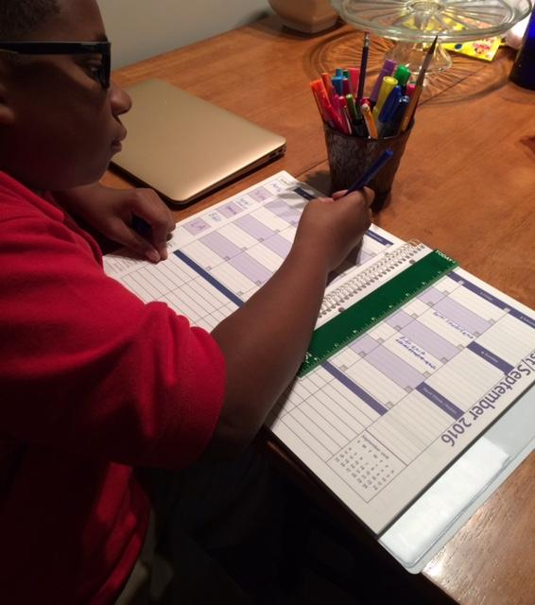
Support Strategies for Home
Build habits
Foster growth mindset
Do not overschedule your child
Schedule Organizing (choose a day)
Use visualization:
Visual Schedule or lists
Planner
Time Timer

Slide 6
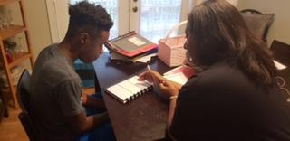
Coaching Strategies for Home
Older Students:
Ask about the plan of attack
Allow for small failures, followed by collaborative problem solving
Use Working Memory Post-Its

Slide 7
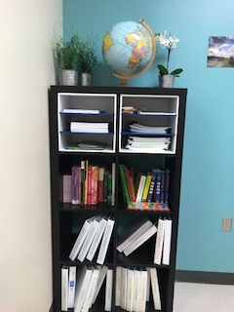
Support Strategies for School
Strengths-based approach
Growth mindset
Environment
Routines
Visuals/Agenda
Time-Management

Slide 8
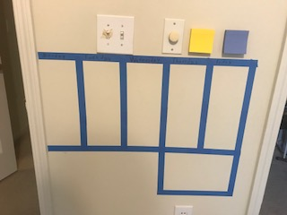
3 Key Items to Remember
They won’t be great at everything.
You are your child’s best advocate.
Use questions and support strategies to coach your child

Slide 9
Resources

