Slide 1
Visual Literacy Through Infographics
Shirley J. Farrell, PhD
Troy University
sfarrell@troy.edu
@shirfarr

Slide 2
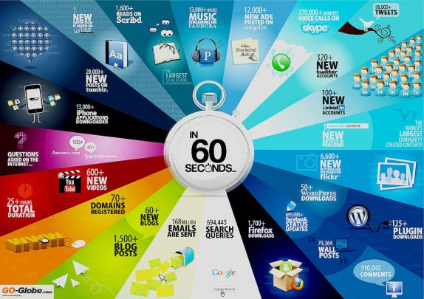

Slide 3
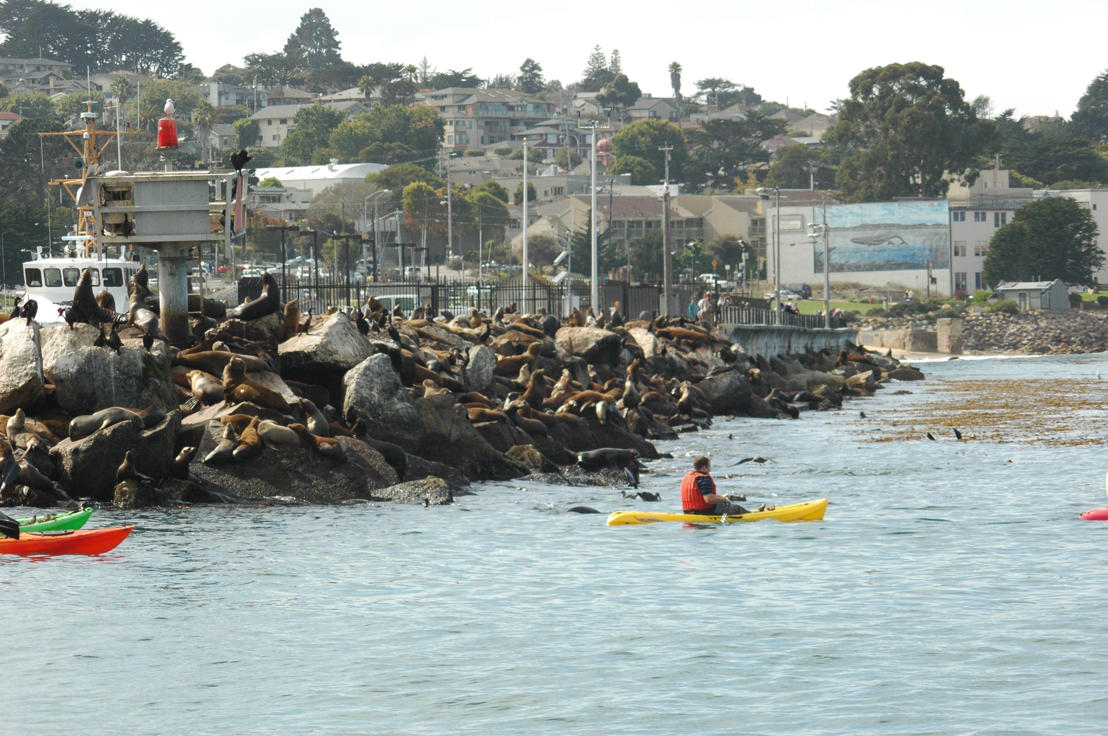
What is Visual Literacy?
Ability to create, interpret, negotiate, and make meaning from information presented in the form of an image.

Slide 4
What is Visual Literacy?
Nonlinguistic Representation-
Mental pictures, graphics, physical sensations (Marzano, et al. 2001)
Integrated Text
Combination of headings, paragraphs, visual elements, and design features (Moline, 1995).
Infographics

Slide 5
What is an Infographic?
An infographic, or information graphics, is a graphic visual representation of text, data, and pictures.
Complex information is presented quickly and clearly.
May reveal information that is hidden or submerged (David Gray)

Slide 6
What is an Infographic?
“Illustrate information that would be unwieldy in text form”
(http://resourcelinkbce.wordpress.com)
“Use both words and visuals, infographics strike the sweet spot where linguistic and nonlinguistic systems converge.” Marzano, 2012
Using both systems, better they can store, recall, and apply new understandings Marzano, 2012

Slide 7
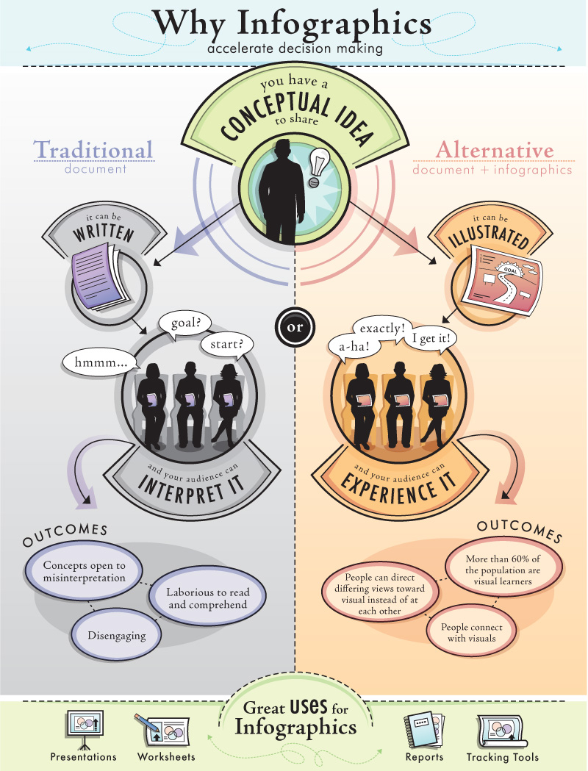

Slide 8
Infographics in Education
Excellent for visual-spatial learners and 2e students
Adds creativity back into the learning
Can be static or animated
Collaborative or individual projects
More fun to grade!

Slide 9
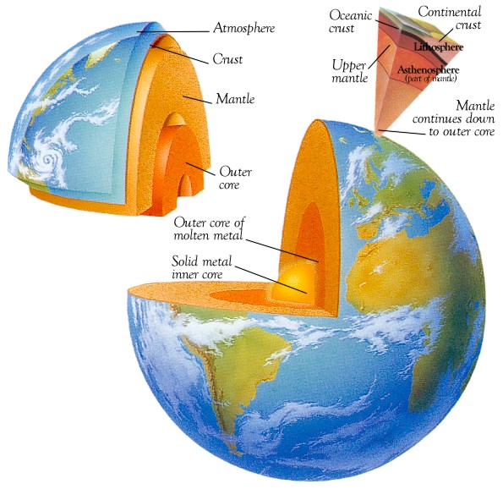
Types of Infographics
Diagrams
Earth Cutaway

Slide 10
Types of Infographics
Timelines
Astor Chocolate

Slide 11
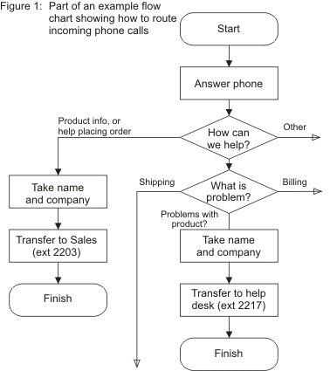
Types of Infographics
Flowcharts
Mind Tools

Slide 12
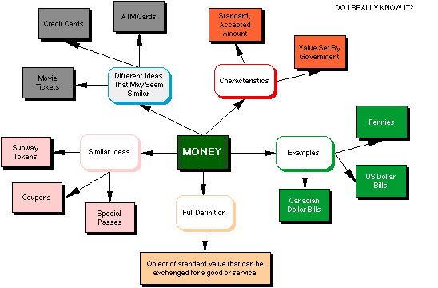
Types of Infographics
Graphic Organizers
Graphics.org

Slide 13
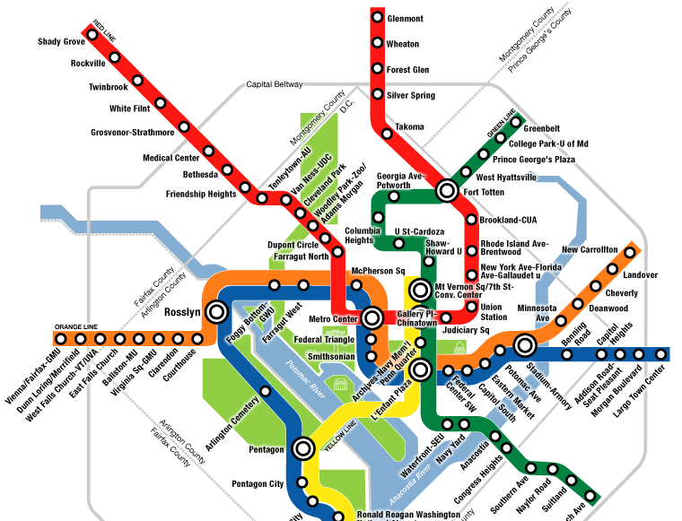
Types of Infographics
Maps
Washington, DC
Metro

Slide 14
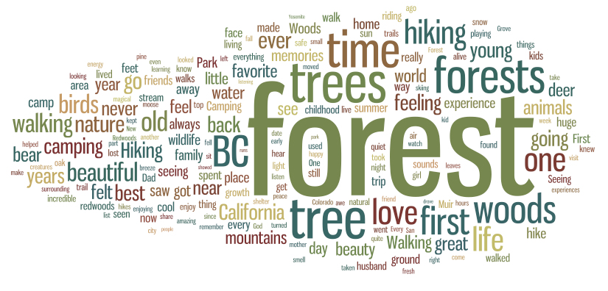
Types of Infographics
Word Clouds
Common Forest Memories

Slide 15
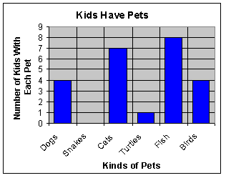
Types of Infographics
Graphs
Pets

Slide 16
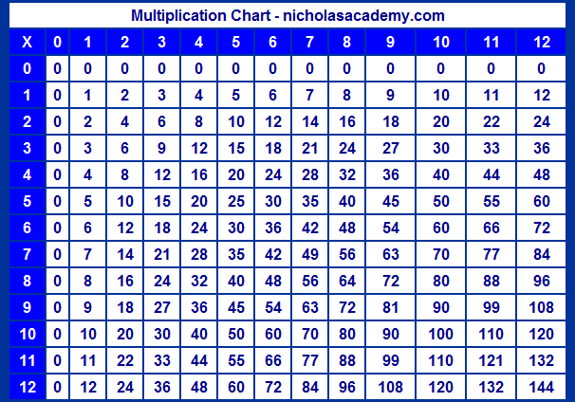
Types of Infographics
Multiplication Table
Tables

Slide 17
Infographics
Can be found
Web sites
Businesses
Communities
Newspapers
Magazines
Books
David McAuley “How Things Work”

Slide 18
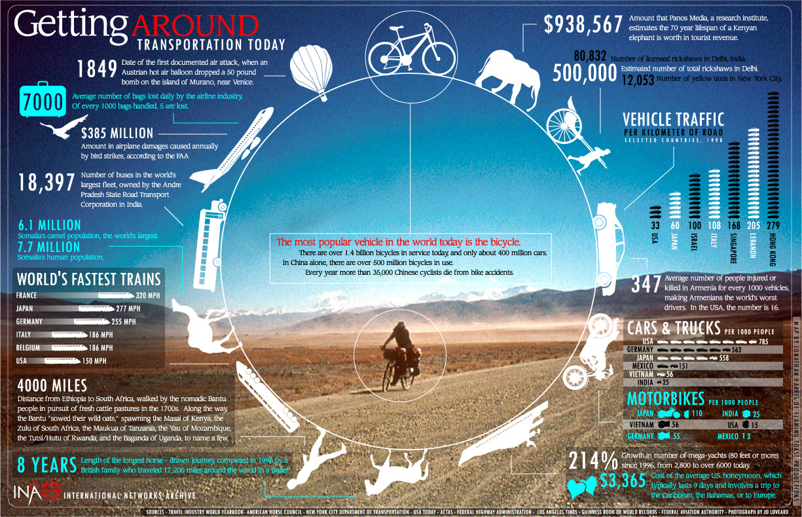
Why Focus on Infographics?
Notes:
http://dailyinfographic.com/getting-around-infographic

Slide 19
High Quality Infographics
Research and Data
Create a good question
Research the information.
Use valid, current data.
Cite all sources.
Skeleton and Flowcharts
Create a flowchart/storyboard of the story.
Color Scheme
Coordinate colors. Less is more!

Slide 20
High Quality Infographics
Graphics
Coordinate icons and graphics to enhance the story.
Knowledge
Be clear.
Keep it simple.
Pay attention.

Slide 21
Infographics
Static Infographic
http://www.creditsesame.com/blog/mobile-payment-apps-05042011/
Interactive Infographic
http://www.visual-literacy.org/periodic_table/periodic_table.html
Animated Infographic
http://www.youtube.com/watch?v=Io-Gh0CBZOA

Slide 22
Infographics
How will you use infographics in your classroom?
Acquire Knowledge
Processing Knowledge
Product
Demonstrating Knowledge
Project
Assessment

Slide 23
Infographics
Everything You Wanted to Know About Creating Infographics:
LiveBinder:
https://tinyurl.com/shirfarr

