Slide 1
The Voices of Gifted Adults: A Focus Group Study
Maggie Brown
www.focusgroupsgifted.auckland.ac.nz
We are not that!

Slide 2
PURPOSE
to add the voices of gifted adults to key conversations emerging within the study of adult giftedness
The study is part of a larger research project including:
www.delphistudy.auckland.ac.nz

Slide 3
?
What is the current state of research & knowledge about gifted adults?
What is needed to develop research that increases our understanding?
How should research efforts be directed in the next 5 years?

Slide 4
Configurative Lit Review
What the published literature says
Delphi Study
What the experts say
Focus Groups
What gifted adults say

Slide 5
Lit Review
Focus Groups
No Voice!
Delphi Study

Slide 6
Focus Group | Group Size | Female | Male
A | 4 | 2 | 2
B | 3 | 2 | 1
C | 5 | 3 | 2
D | 3 | 2 | 1
Canada, USA, Switzerland, Germany, the Netherlands, Australia, New Zealand & South Korea.

Slide 7
ThematicANALYSIS
Not tied to theory
Grounded
Emergent
Braun, V., & Clarke, V. (2006). Using thematic analysis in psychology. Qualitative Research in Psychology, 3(2), 77-101.

Slide 8
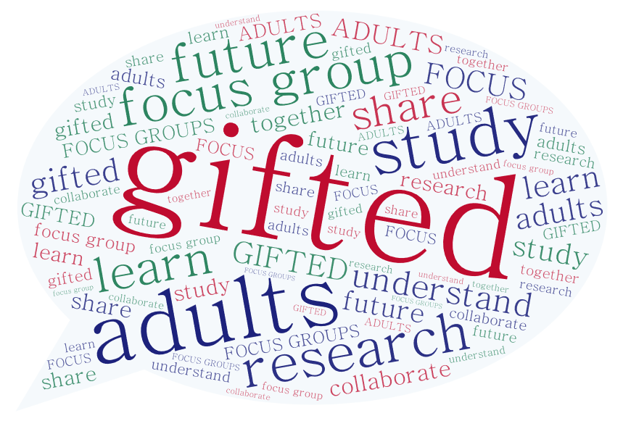
We are not that!
Trapped within the usual narrative
Othering: out of place and somehow ‘wrong’
Values are being imposed

Slide 9
?
What is the current state of research & knowledge about gifted adults?
What is needed to develop research that increases our understanding?
How should research efforts be directed in the next 5 years?

Slide 10
However it happens, research needs to respond to real needs and issues
Broaden the narrative to include what is important to gifted adults
Value the lived experiences – listen to those stories!
Create space in research programs and academic journals for qualitative methods
TO PARAPHRASE REYNOLDS AND PIIRTO, 2005:
“Let’s bring the soul back into our narratives”

Slide 11
The Voices of Gifted Adults: A Focus Group Study
Maggie Brown
maggie.brown@auckland.ac.nz
www.focusgroupsgifted.auckland.ac.nz
www.maggiebrown.co
We are not that!

