Slide 1
Critical Questioning:
Differentiating for High-Ability Students
Seth Jaeger
Coordinator of Gifted Programs
Colegio Nueva Granada
Bogotá, Colombia
Notes:
One of the biggest challenges for any teacher is figure out how best to reach all the students in your classroom. While much attention is devoted to providing support

Slide 3
Land Acknowledgement
In a modest gesture, I would like to acknowledge that Nashville is built on the ancestral lands of the Shawnee, Cherokee and Choctaw People. As a visitor, I would like to pay my respects to the elders and descendants who have stewarded these lands in support of larger truth-telling and reconciliation efforts.
https://usdac.us/nativeland

Slide 4
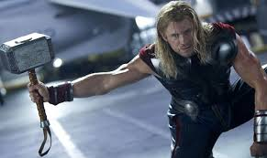
Question
If you could will an object to you like Thor does his hammer, what would it be?

Slide 5
Objectives
“Make the case” for for student questioning
Identify protocols for developing questioning skills
Describe and practice the “5 Habits of Mind” for Critical Questioning
Explore Applications and Resources for Student Questioning
Notes:
Make the case for for student questioning
Describe protocols for developing questioning skills
Practice using the question formulation technique
Identify the “5 Habits of Mind” for Critical Questioning
Explore Applications and Resources for Student Questioning

Slide 6
Agenda
The Case for Questioning
Tools for Questioning
What to do with questions?
Reflecting on Questioning
Resources for Questioning
Notes:
The Case for Questioning
Tools for Questioning
What to do with questions?
Reflecting on Questioning
Resources for Questioning

Slide 7
Empowering High-Ability Students
“There is often a mismatch between the academic needs of a student and the pace and depth or complexity of the curricula and instructional program”. -VanTassel-Baska & Hubbard, 2016
“Teachers in [heterogeneous] classrooms will need to be proficient in “teaching up,” or planning learning experiences at a high level of challenge while providing scaffolding to support many learners in succeeding with those experiences and extending the challenge in a meaningful way for advanced learners”. -Tomlinson, 2015
Notes:
Students finish assignments faster, get bored and can become disengaged . QUestioning allows for instant differentiation because students are developing questions appropriate for their ability and interests and empowered to seek out answers in the process of inquiry.

Slide 9
Why Question?
“There is no learning without having to pose a question. And a question requires doubt”.
-Nobel Physicist Richard Feynman
“Thinking is not driven by answers but by questions. Had no questions been asked by those who laid the foundation for a field…the field would never have developed in the first place”.
-Richard Paul and Linda Elder,
Foundation for Critical Thinking
Notes:
“There is no learning without having to pose a question. And a question requires doubt”.
-Nobel Physicist Richard Feynman
“Thinking is not driven by answers but by questions. Had no questions been asked by those who laid the foundation for a field…the field would never have developed in the first place”.
-Richard Paul and Linda Elder,
Foundation for Critical Thinking

Slide 10
Why Question?
Increase student engagement
evaluating students' preparation and comprehension
diagnosing students' strengths and weaknesses
reviewing and/or summarizing content
encouraging students to think more deeply and critically
problem solving
encouraging discussions
stimulating students to seek information on their own
“Questioning Strategies.” Center for Teaching Excellence. University of Illinois at Urbana-Champaign. http://cte.illinois.edu/resources/topics/methods/strateg.html.
Notes:
Increase student engagement
evaluating students' preparation and comprehension
diagnosing students' strengths and weaknesses
reviewing and/or summarizing content
encouraging students to think more deeply and critically
problem solving
encouraging discussions
stimulating students to seek information on their own
“Questioning Strategies.” Center for Teaching Excellence. University of Illinois at Urbana-Champaign. http://cte.illinois.edu/resources/topics/methods/strateg.html.
It transforms learning students designing questions promotes deeper understanding, reveal misconceptions and expose student interest. When students create questions they are more inclined to answer.Students should be working (“whoever is the worker is the learner”)

Slide 11
Why Question?
Self-questioning (metacognitive strategy):
Student formulation of their own questions is one of the most effective metacognitive strategies
Engaging in pre-lesson self-questioning improved students rate of learning by nearly 50% (Hattie, p.193)
John Hattie
Visible Learning: A Synthesis of Over 800
Meta-Analyses Relating to Achievement, 2008
Notes:
Self-questioning (metacognitive strategy):
Student formulation of their own questions is one of the most effective metacognitive strategies
Engaging in pre-lesson self-questioning improved students rate of learning by nearly 50% (Hattie, p.193)
John Hattie
Visible Learning: A Synthesis of Over 800
Meta-Analyses Relating to Achievement, 2008

Slide 12
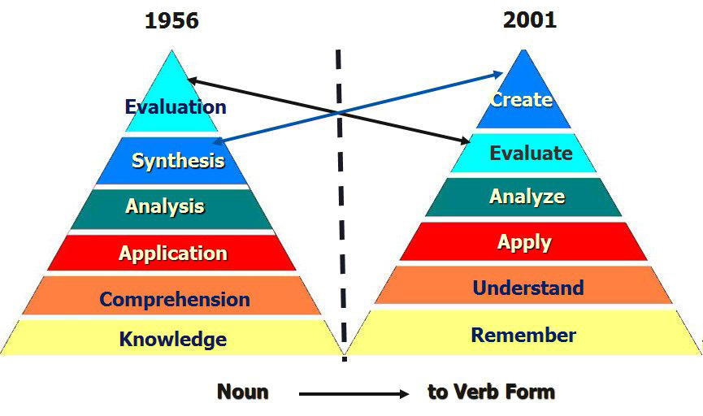
HOTS through Questioning
Bloom’s and Revised Bloom’s
Anderson & Krauthwohl, et. al (2001)

Slide 13
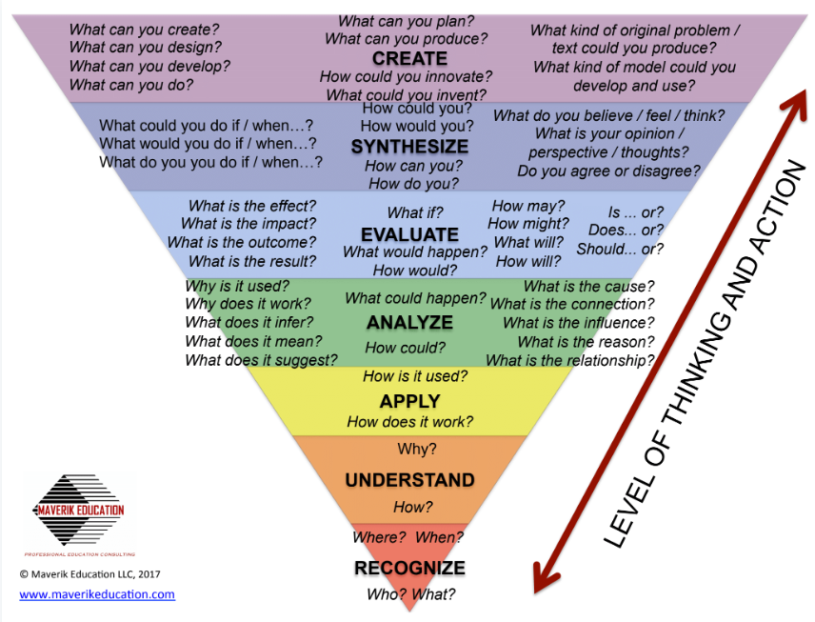
HOTS through Questioning
Bloom’s and Revised Bloom’s

Slide 14
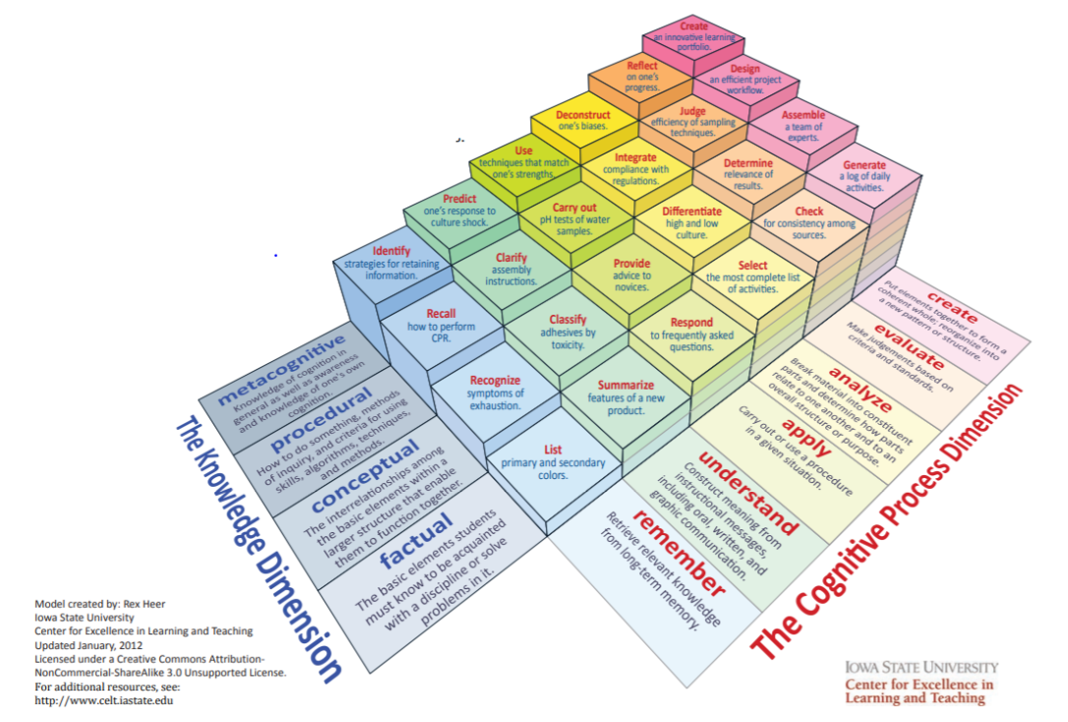
Heer (2012) Model of Learning Objectives

Slide 15
Protocols for Questions
Think Pair Square
10x10
Ladder of Inference
Question Formulation Technique
5 Habits Framework
Notes:
They are pairing with somebody to compare their questions and pull out the best questions, the two best questions with their partner, and then they are squaring with somebody else to discuss those and share those best questions.
10 by 10, it's turned 10 by 10 because students generate 10 questions in ten minutes. On visuals related to the class theme.

Slide 16
5 Habits of Mind/Critical Questioning
Developing Questions of:
1) Evidence (How do I know what's true?)
2) Perspective (Who might think differently?)
3) Connections (What other areas of knowledge are connected?)
4) Supposition (How might it be different if..?)
5) Significance (Is this important?)
Notes:
Habits of Mind are dispositions that are skillfully and mindfully employed by characteristically intelligent, successful people when they are confronted with problems, the solutions to which are not immediately apparent. When we draw upon these mental resources, the results are more powerful, of higher quality, and of greater significance than if we fail to employ those habits

Slide 23
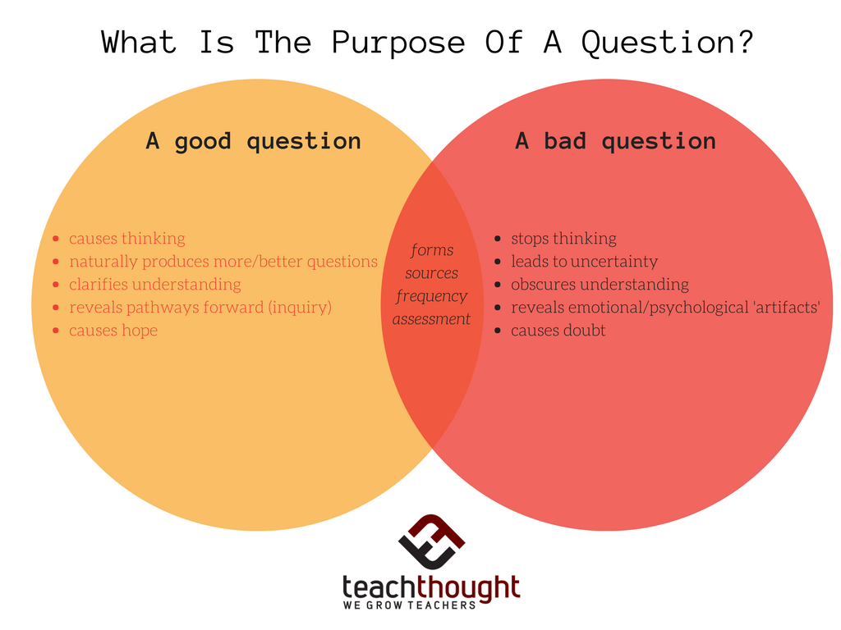
What is the Purpose of a Question?

Slide 24
Question Formulation Technique
1. The Question Focus (QFocus) 2. The Rules for Producing Questions 3. Producing Questions 4. Categorizing Questions 5. Prioritizing Questions 6. Next Steps 7. Reflection
Right Question Institute, 2018
Notes:
What started out as tool for transforming learning , the authors envision it as a pro democracy tool for empowering partnerships between patients and their healthcare profressionals or between citizens and their elected officials.

Slide 25
Question Formulation Technique
“There are some questions that shouldn't be asked until a person is mature enough to appreciate the answers.”
― Anne Bishop, Daughter of the Blood
Notes:
“There are some questions that shouldn't be asked until a person is mature enough to appreciate the answers.”
― Anne Bishop, Daughter of the Blood

Slide 26
Question Formulation Technique
Four essential rules for producing your own questions: • Ask as many questions as you can (Gives License to Ask).
• Do not stop to discuss, judge, or answer the questions (Creates Safe Space and Protection).
• Write down every question exactly as it is stated (Levels the Playing Field So All Questions and Voices Are Respected).
• Change any statement into a question (Insists on the Discipline of Phrasing, Asking, and Thinking in Questions, Not Statement).
Notes:
Four essential rules for producing your own questions: • Ask as many questions as you can (Gives License to Ask).
• Do not stop to discuss, judge, or answer the questions (Creates Safe Space and Protection).
• Write down every question exactly as it is stated (Levels the Playing Field So All Questions and Voices Are Respected).
• Change any statement into a question (Insists on the Discipline of Phrasing, Asking, and Thinking in Questions, Not Statement).

Slide 27
Question Formulation Technique
“There are some questions that shouldn't be asked until a person is mature enough to appreciate the answers.”
― Anne Bishop, Daughter of the Blood

Slide 28
Question Formulation Technique
STEP 2: Improve Your Questions • Categorize the questions as closed- or open-ended. • Name the advantages and disadvantages of each type of question. • Change questions from one type to another.
Notes:
STEP 2: Improve Your Questions • Categorize the questions as closed- or open-ended. • Name the advantages and disadvantages of each type of question. • Change questions from one type to another.

Slide 29
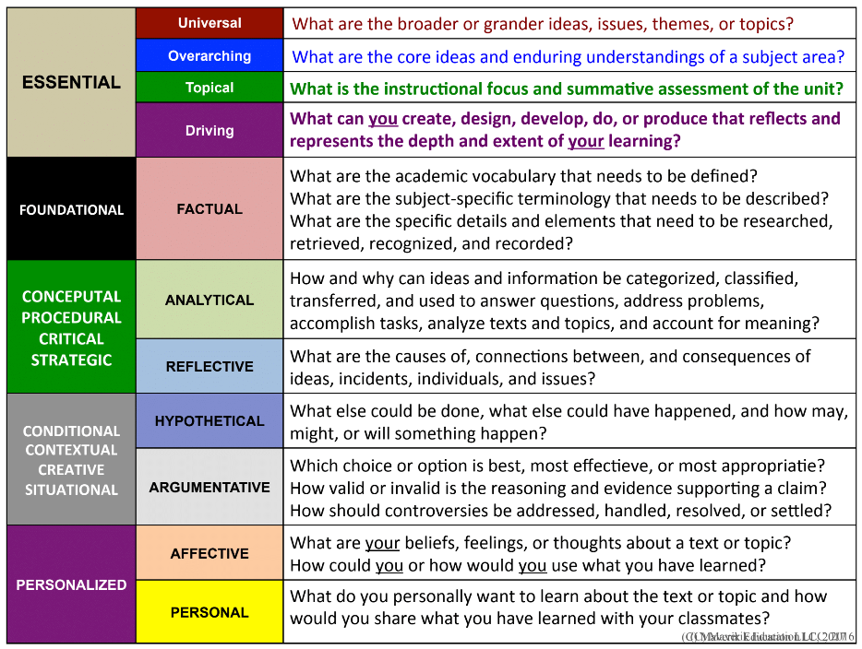
Categorizing Questions

Slide 30
Building A Better Question
Question Stem + Concept + Category +
Topic + Conjunctions, Articles, etc.
=A Driving Question

Slide 31
Building A Better Question

Slide 32
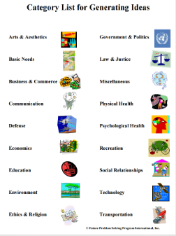
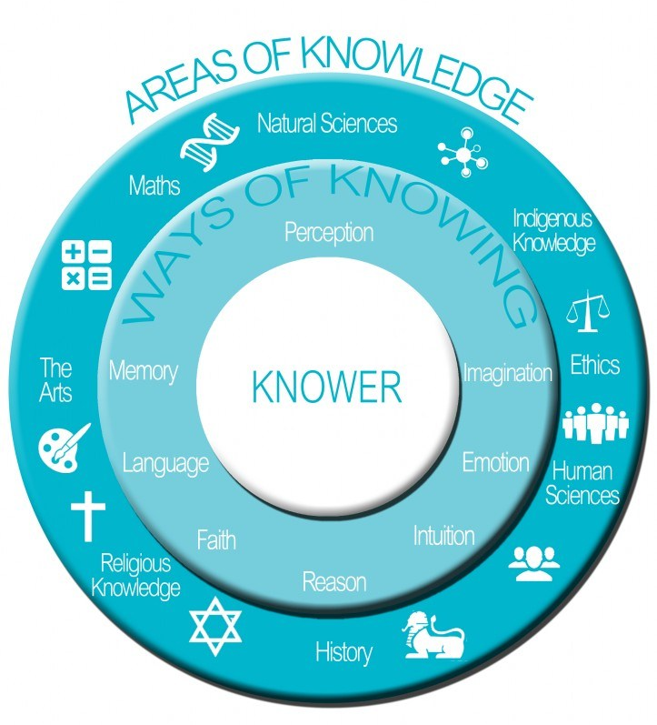
Building A Better Question

Slide 33
Categorizing Questions
Notes:
Essential , foundational, conceptual, conditional and contextual, personalized

Slide 34
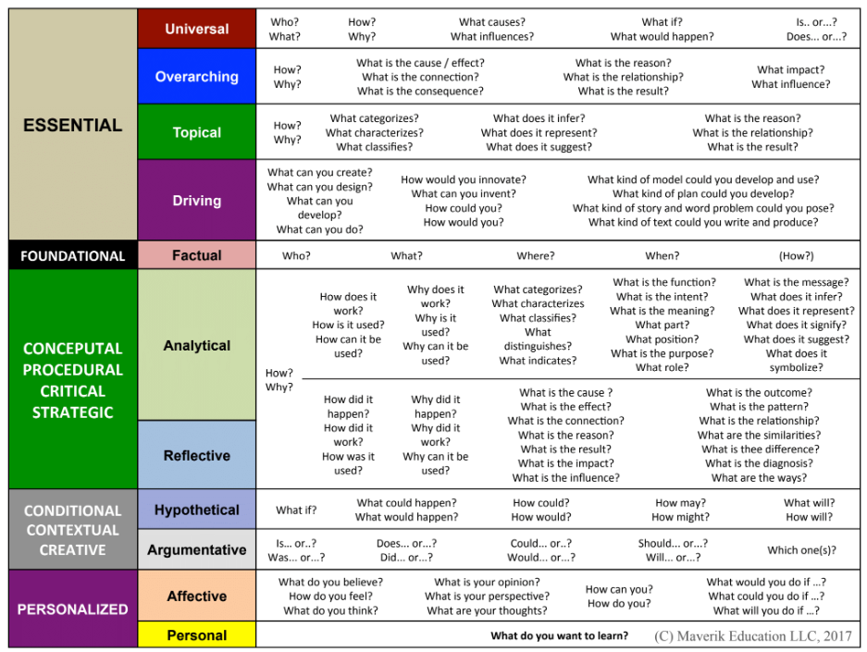
Categorizing Questions

Slide 36
Question Formulation Technique
STEP 2: Improve Your Questions • Categorize the questions as closed- or open-ended. • Name the advantages and disadvantages of each type of question. • Change questions from one type to another.
STEP 3: Prioritize the Questions • Choose your three most important questions. • Why did you choose these three as the most important?
Notes:
STEP 2: Improve Your Questions • Categorize the questions as closed- or open-ended. • Name the advantages and disadvantages of each type of question. • Change questions from one type to another.

Slide 37
Question Formulation Technique
Next Steps • How are you going to use your questions??
Notes:
Next Steps • How are you going to use your questions??

Slide 38
How are you going to use your questions??
Conduct Research
Reports
Perform Experiments
Independent Projects
Write Papers/ Essays
Group and Individual Projects
Socratic Seminars/ Debates
Prepare for Presentations/Interviews
Promote global awareness through Mystery Skype
Notes:
Conduct Research
Reports
Perform Experiments
Independent Projects
Write Papers/ Essays
Group and Individual Projects
Socratic Seminars/ Debates
Prepare for Presentations/Interviews
Mystery skype

Slide 39
Reflecting on Questioning
Did it stimulate deeper thinking?
Did it deepen knowledge, understanding, and awareness?
Did it expand knowledge and extend thinking?
Did it pique curiosity, imagination, interest, and wonder?
Did it allow students to express and share learning in their own unique way?
Notes:
Did it stimulate deeper thinking?
DId it deepens knowledge, understanding, and awareness?
Did it expand knowledge and extend thinking?
Did it pique curiosity, imagination, interest, and wonder?
Did it allow students to express and share learning in their own unique way?

Slide 40
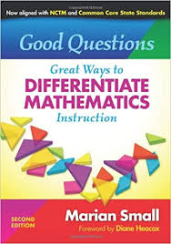
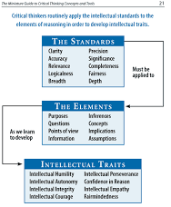
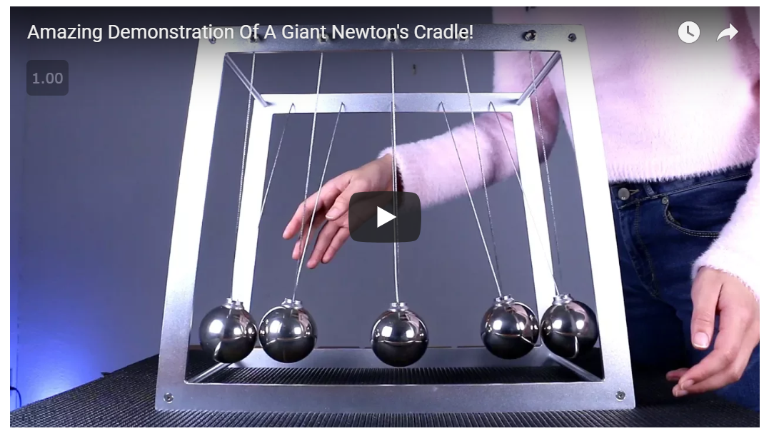
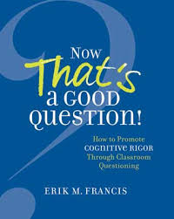
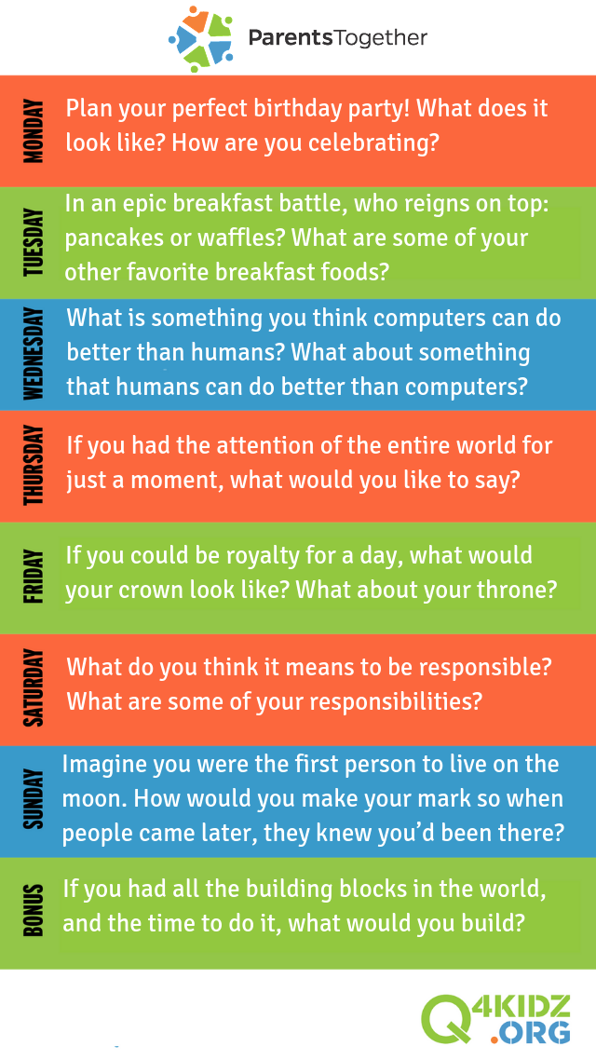
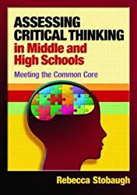
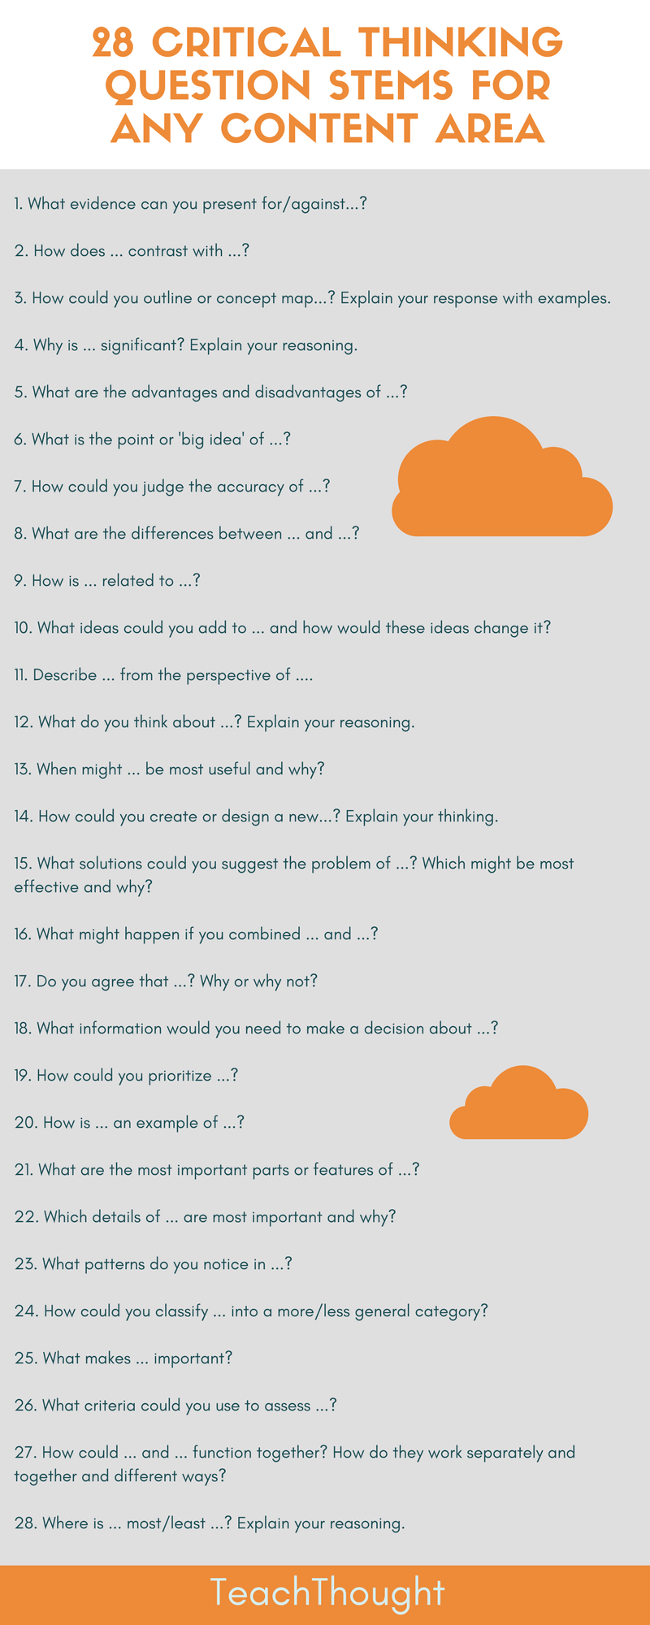
Resources for Questioning
Paul Andersen: Untamed Science
Graham Fletcher: 3 Act Tasks

Slide 41
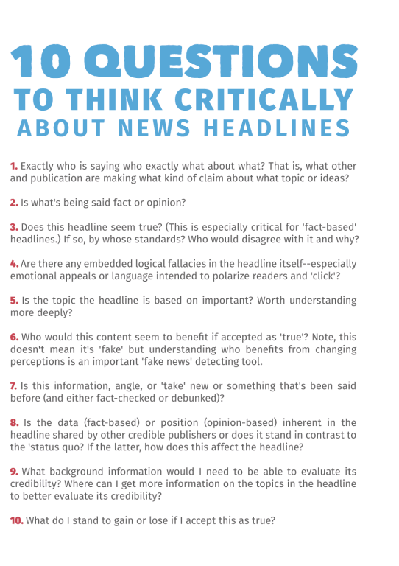
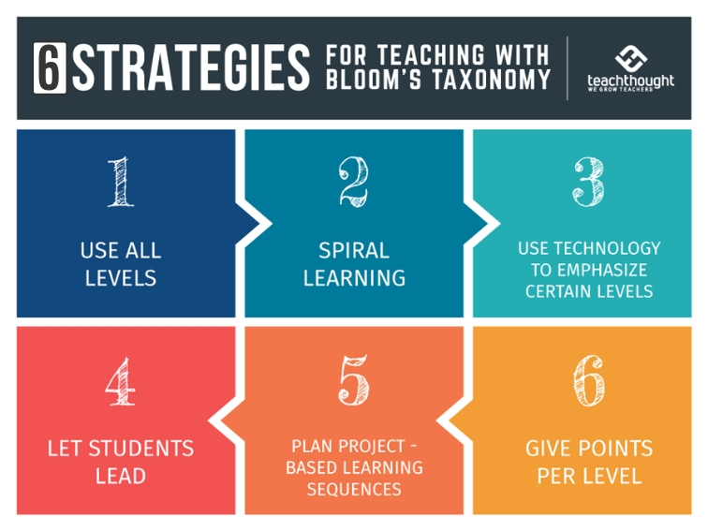
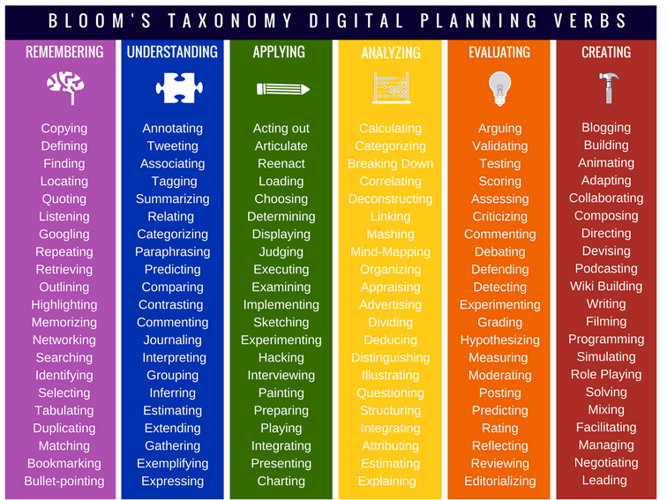
Resources for Questioning
Notes:
https://www.teachthought.com/pedagogy/using-blooms-taxonomy-21st-century-4-strategies-for-teaching/

Slide 42
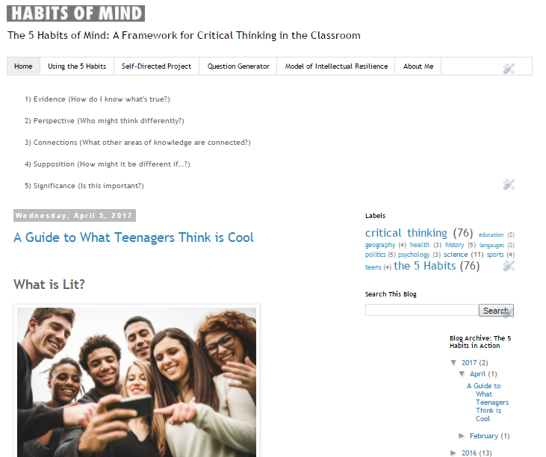
Resources for Questioning

Slide 43
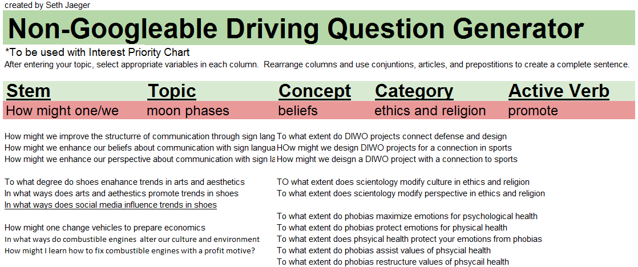
Resources for Questioning

Slide 44
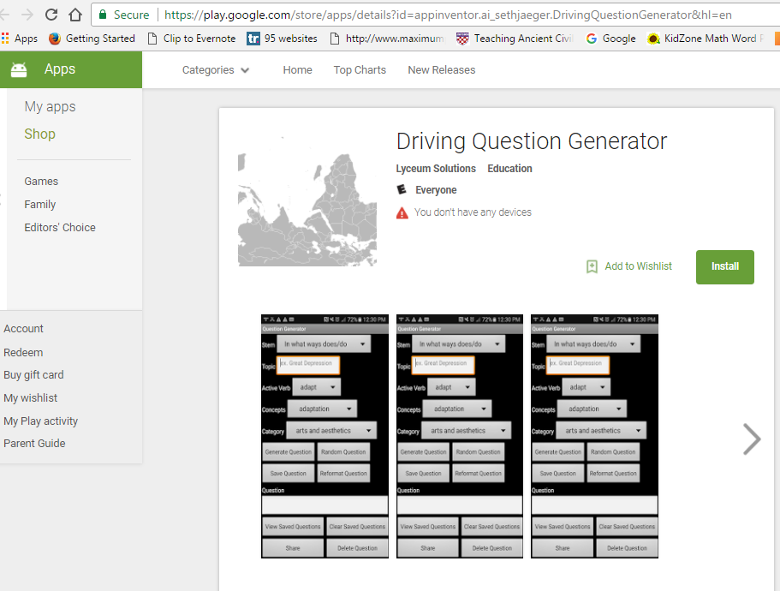
Resources for Questioning

Slide 46
Citations
Anderson, L.W., Krathwohl, D. (ed). A taxonomy for learning, teaching, and assessing: a revision of Bloom’s taxonomy of educational objectives. New York: Longman, 2001.
Kingore, Bertie W. Rigor and Engagement for Growing Minds: Strategies That Enable High-Ability Learners to Flourish in All Classrooms. PA Publishing, 2013.
“Questioning Strategies.” Center for Teaching Excellence. University of Illinois at Urbana-Champaign. http://cte.illinois.edu/resources/topics/methods/strateg.html.
Rothstein, D. & Santana, L. (2011). Make just one change: Teach students to ask their own questions. Cambridge, MA: Harvard University Press.
Tomlinson, C. A. (2015). Teaching for excellence in academically diverse classrooms. Society, 52(3), 203-209.
VanTassel-Baska, J., & Hubbard, G. F. (2016). Classroom-based strategies for advanced learners in rural settings. Journal of Advanced Academics, 27(4), 285-310.

