Slide 1
EMPATHY in ACTION
A Toolkit
for the
Classroom

Slide 2
Presenters: Beth Hahn Karen Qualls Diane Witt

Slide 3
A World Of Changing Expectations And Fluid Events
Instagram
Society’s voices are technology and digital media
Teachers face very diverse classrooms
Snapchat Google Twitter
Facebook
Notes:
We are living in a world of changing expectations and fluid events that are affected by the day’s news. Technology and digital media provide the voices of our society and influence the way our children act and respond to facebook, instagram, twitter to name a few. Educators now experience classrooms with students from many backgrounds.

Slide 4
First, let’s look at a few cautions. . .
Our students need to learn social-emotional skills, and our teachers are so busy that programs that can be rolled out quickly and easily seem like a quick fix to the problem. However, in reviewing many of these programs (those referred to both as social-emotional skills programs or character building programs), it is apparent that these programs do not meet the needs of our gifted students for several reasons, and most could be downright dangerous for our most at-risk gifted children.
--Kathleen Casper
Notes:
Dangers: overly sequential, not based on real life experiences, not created for gifted children’s needs, forced partnering, friendship issues (often don’t relate to others in class), embarrassment (don’t see humor in some activities), based on blind school pride, parent support needs, assumed age level barriers, often taught as “characteristic of the month”, limited teacher training.
Kathleen Casper has written for SENG publications and the NAGC blog.

Slide 5
What is the connecting link?
Notes:
The connecting link is the manner in which we relate to one another. The dictionary refers to this “caring” as empathy. It reflects an understanding of the human condition and one another. Unfortunately, it seems to be getting harder to find. According to Psychology Today, “American culture is socializing people to become more individualistic rather than empathetic. Good in one way, bad in another.”
This presentation looks to foster those behaviors that bring out the best in our students, those who serve them, and the greater community.

Slide 6
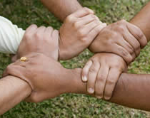
This presentation looks to foster those empathetic behaviors that bring out the best in our students, those who serve them, and the greater community.
This Photo by Unknown Author is licensed under CC BY-SA

Slide 7
9 Empathy Habits
Literacy
Make a Difference
Identity
Identified by Dr. Michele Borba
Empathetic children use these habits to address emotional and ethical challenges
All are teachable
Risk Taking
Perspectives
Collaboration
Imagination
Kindness
Self Regulation
Notes:
The nine habits are ones that highly empathetic children exhibit and that help to make them effective in their interactions in daily life.

Slide 8
9 Habits
Literacy
Empathy Habits
Identified by Dr. Michele Borba
Empathetic children use these habits to address emotional and ethical challenges
All are teachable
Identity
Perspectives
Imagination
Self Regulation
Kindness
Collaboration
Risk Taking
Make a Difference
Notes:
The nine habits are ones that highly empathetic children exhibit and that help to make them effective in their interactions in daily life.

Slide 9
So. . . how do we teach and measure development of empathy habits?
Characteristics of gifted learners
Classroom learning culture that fosters empathy
Service learning
Simulations such as mock trials
Problem based learning
Books for reading that model empathy habits
Rubrics and rating scales
Notes:
After reviewing these canned programs, it is clear that the best way for us to sufficiently meet the needs of our gifted population is to be trained in their unique characteristics and needs and to truly understand what types of social emotional skills they may have and what they need to work on. It is worth noting that if something is touted as meeting the social emotional needs of an entire student population, it almost certainly will not be able to accomplish that goal due to the diversity of the all children, and children who are gifted cannot be put in a particular box either- gifted children have various interests and different social emotional issues even from each other. This is why there is no canned curriculum claiming to meet the needs of “all” gifted children. There are rubrics and rating scales that can help educators and parents gauge where gifted children are in terms of social emotional development and needs, but for the most part it is best to get to know the children we work with. Using the research and strategies that we learn through our professional development on gifted education issues helps us to best provide them with learning environments rich with interesting materials and challenges that keep them engaged and willing to try new things - Katherine Casper
Children’s Books: https://www.doinggoodtogether.org/bhf/read-together/?gclid=CjwKCAjw-dXaBRAEEiwAbwCi5maDn9RBNWNCSNbDpIr22lhXTeZKCC3un6SeLQsiqAYjy5nYlNMTqhoCCW0QAvD_BwE

Slide 10
©2018
9 Empathy Habits for Gifted Learners
©2018
Notes:
©2018
Developing empathy skills is a little like practicing yoga. You have to do it every day and grow more flexible and balanced each day.

Slide 11
Literacy - tuning in to emotions of ourselves and those around us.
Gifted Characteristic – unusual alertness, intense awareness of surroundings and sensitivity to other peoples’ reactions. Relates to those less fortunate.
Notes:
Gaining Literacy
Understanding Others
Feeling What Others Feel
Slide 11 Literacy- tuning in to emotions of ourselves and those around us.
Gaining literacy,
Understanding others
Feeling what others feel
Strategy: Active listening
Chen, Amanda,( 2018)16 Habits of Highly Sensitive people. Retrieved July 25 from https://www.huffingtonpost.com.
High Sensitivity:
Are highly intuitive as they feel more deeply and often react more to a negative event.
Prefer individual sports
Takes them a long time to make decisions
Are prone to anxiety
Overstimulated easily
Cry easily
React to criticism
Practicing Active Listening
Cuncic, Arlin,(2017) How to Practice Active Listening, Retrieved July 25, 2018 from https://www.verywellmind.com/what-is-active-listening-3024343.
Is a process when someone else is speaking
Reflect back what her speaker is saying
Make eye contact
Refrain from making eye contact
Do not offer advice
Be patient
With hold judgement
Strategy: active listening

Slide 12
Identity – how do I want to treat others?
Gifted characteristic –recognizes own feelings; feels deeply with intense emotions for certain topics; acknowledges injustice to others; idealistic view of the world; places high standards on themselves.
Notes:
Creating Identity
Understanding Myself
Strategy: practice mindfulness
Slide 12 Identity- how do I want to treat others
Creating Identity
Understanding myself
Strategy: Practicing Mindfulness
Devries, Arlene, (2011) Appropriate Expectations for the Gifted Child, retrieved July 20, 2018 from https://seng.gifted.org/appropriate-expectations-for-the-gifted-child.
Bright students have unreasonable expectations
Parents are often in agreement with teachers
Students thrive when allowed to follow their passions
Demonstrate sensitivity to society’s injustice of others
Many experience feelings of inferiority
Parents need to realize that sensitivity does not mean weakness
They are children first and gifted second
Too often anything short of perfect is not good enough.
Mindfulness:
Being tuned in to what is happening
Improve listening, empathy
Ways to mindfulness:
Experience nature
Learn how to accept the present

Slide 13
Perspectives – stepping into another’s shoes to understand their thoughts, feelings and views.
Gifted characteristic –
ability to see situations from more than one point of view.
Notes:
Recognizing Perspectives
Multiple Points of View
Walk Two Moons - book Author had discovered a fortune cookie message in the bottom of my purse and the message was: "Don't judge a man until you've walked two moons in his moccasins."
Strategy: Active Listening
Stepping into another’s shoes to understand their thoughts, feelings and views.
Characteristics: Ability to see more than one viewpoint on a topic
Flexible thinking. Can you do it? Can your students? Did you know this flexibility in thinking also leads to creativity and diplomacy, or the ability to negotiate what you want?
Recognizing Perspectives Multiple Points of view
Walk on Two Moons- book author discovered a fortune cookie message in the bottom of my purse and the message was: Don’t judge a man until you’ve walked two moons in his moccasins.
Active listening
Mueller, Steve, March 31, 2017. Retreived Aug. 4, 2018 from https:// planetsuccess.com/blog.2011/developing-empathy-walk-a-mile-in-someone’s-shoes/

Slide 14
Imagination – using literature, drama, film and visual images to feel what
others are feeling.
Gifted characteristic -
expresses sensitivity and sadness to
literature, movies, and music; vivid imagination.
Notes:
Using Imagination
Insights
Strategies: drama, role play, simulation
Express sensitivity and sadness to music, arts and literature
Since you have chosen to take part in this conference, I’m sure you’ve noticed children and adults relate to music, art and literature. Emotions experienced in the arts and music can trigger strong feelings that cannot always be ignored, but it’s not just that. This intensity can be expressed through tears, happiness or happiness. These feelings can emerge when being around the disabled, elderly or those less fortunate.
In another life, I worked with young students who were extremely disabled, both mentally and physically. Working with schools in the district, classes received information about differences and learned how it felt to be blind or other disability through simulations. The schools were invited to spend a day with the students to learn more about differences. While there, they learned about a young boy, about 8 years old that had just learned how to take the spoon to his mouth and another student of around two feet tall that could use his walker to walk down to lunch. Great achievements for them, but for some, they had to leave the room, tears shed for a couple and others were anxious for what they could do to make friends.
Assuring these kids “its ok ”is one of the most positive actions an educator can do and help them realize we care. These early experiences in understanding empathy can have an impact of their perceptions toward music, the arts, literature and differences.
Gifted Children: Emotionally immature or emotionally intense? (n.d.). Retrieved 7/26/2018 from www.davidson.org.search-database/entry/Al0241

Slide 15
Self Regulation – managing strong emotions and personal distress.
Gifted characteristic –
longer attention span and intense concentration; preoccupied with own thoughts.
Notes:
Exercising Self-Regulation
Strategy: Practice Mindfulness
Balancing Act
Mindfulness and Balancing act
Do you know this child? Perhaps he is in your class. Conner is in the sixth grade. He has ADHD and daydreams, finds it difficult to write, but knows math and loves sports. There are strategies to help with these issues, but it is a balancing act. He is also the first one to notice if someone needs help and always sticks up for his peers if he feels they have been treated unfairly, but organizing can be a problem.
There are strategies that can help. They include goal setting ,organizing and breaking how to study and learning how to take charge of his lessons
Mindfulness is also another option for this kind of student. They need assistance in how to be more focused and less anxious. It is a way to help reinforce calmness in the classroom, especially now in the time of so many distractions, such as cell phones, other devices and digital media. Helping students focus on their thinking is a tool that can help all classroom. There are now instructors available to come to your school to reinforce this topic and how it can help “cut the clutter of noise out there.” and help meet your school’s needs.
Mindfulness Programs for Teachers.(nd.). August 2, 2018 from www.brilliantmindfulness.com-for-teachers2/
Reis, Sally. M.(nd).Self-Regulated Learning and Academically Talented Students. Retrieved July 29,2018 fromwww.davidsongifted.org/SearchDatabase/entryA10460

Slide 16
Kindness – practicing helping others.
Gifted Characteristic –
expresses kindness to peers, elderly, strangers and animals; deep, intense feelings and reactions.
Notes:
Practicing Kindness
Observes models of people practicing kindness
Reads books about kind acts
practicing helping others
Expresses kindness to peers, elderly and animals
Has deep/intense feelings
Helping others. Reaching out and a sense of good for others. Teaching kindness and generosity begins at home. It also begins at an early age and you can even see it in behavior with animals. Young children look after their brothers and sisters. They share their food, even with the pets and they express happiness at having done so.
Kindness can be taught through stories, movies and watching others. Often they begin to see others in a different light and their kindness to others will last through a lifetime. As “Snoopy” once said,” A random act of kindness, no matter how small it is can make a tremendous impact on someone else’s life.”
40 Kindness Activities and Empathy Worksheets for students and adults, .Positive Psychology Program
Retrieved August1,2018 from https://positivepsychologyprogram.kindness-activities-empathy-worksheets/#teachkindness

Slide 17
Collaboration – working together to achieve shared goals that will help all.
Gifted Characteristic –
desire to organize people/things through games or complex schemas.
Notes:
Being Collaborative
Working Together
The Round Table Effect
Strategy: active listening
Working together to achieve shared goals that will help all
Gifted Characteristics: Desire to organize people/ things through games or organizations
Being collaborative
Working Together
The Round Table Effect
Strategy: Active Listening
If any of you have ever worked on an event or large project you know the value of working together is based on the willingness of the team to work together. This group can consist of all kinds of collaborative options, such as non-profits, higher education or companies. The work can be for a mutual-advantage, or as in a business merger. Boards and teams share knowledge share teams, knowledge, costs and information.
This concept is especially effective in the classroom, where gifted kids and the regular classroom students work together to solve a problem. You know them. As the teams come together, a leader emerges with all kinds of ideas and the race is on to find a solution.
These collaborations provide the opportunity for students to work in groups that can emphasize interests and abilities. This collaboration benefits the students as they prepare for the working environment after their education. At the present time, tools like active listening, cooperation and respect for peers develop as they are introduced to the future of business.
Adams, D.M. and Rotondi, Mary A.M. Jan./Feb. 1990, volume 30, article 5. Retrieved August 5, 2018 from https://scholarworks.wmich.edu.
What is Collaborative Working?, Nov.18,2016. Retrieved August 2, 2018 from https://knowhownonprofit.org/

Slide 18
Risk Taking – having the courage to speak out or act to help others.
Gifted Characteristic –
willing to take risks for others; often idealistic and have a sense of justice at an early age.
Notes:
Acting Courageously
Having the courage to speak out or help others
Gifted Characteristics: Willing to take risks for others
Often idealistic and have a sense of justice at an early ate.
You’ve seen them in action. Boys and girls alike listening and anticipating what will happen next, willing to try new things while other stand and listen, often unable to react. These kids seem to adjust to change and adversity without problem and are less likely to have a fear of failing, while at the same time being perfectionists and highly sensitive.
They go full speed ahead through their studies and want or need more to keep them challenged, while failure is not an option. They are the one to go to the aid of others if no one is around and are often the emerging “hero” as they recognize a call for help.
These children also exhibit a high sensitivity in their concern for others. They experience extreme emotions and also feelings of shyness. They have a clear sense of right and wrong and do not tolerate cruelty to others.
This compassion and fairness leads them to speak up for others needs as they begin to fight for
justice for their classmates, against violence and in self defense. Amazingly, these behaviors begin at an early age. After hearing about an earthquake in Russia, a 2/12 year old in tears begged her mom to “send money.”Both boys and girls are worriers and this feeling of empathy can have life long effects for good.
Post, Gail, PhD. Gifted Challenges. “Beyond Intellect: Exploring the Social and Emotional Aspects of Giftedness.” A Life Lesson for Gifted Children: failure. Retrieved August 4,2018 from https://giftedchallenges.blogspot.com
Silverman, Linda Kreger, Sept.14. 1011. The Moral Sensitivity of Gifted Children and the Evolution of Society, Retrieved August 5,2018fromhttps://www.sengifted.org/

Slide 19
Making a difference – acting to change
things for the better for others even in
a small way.
Gifted Characteristic –
concerned with social and political issues and injustices; want to make "wrongs right“ by becoming a positive force in their community; sometimes believe they can "save the world”.
Notes:
Making a Difference
Make the world a better place
Strategy: Positive Activism
Acting courageously
Positive activism – concerned with social and political activism, Wants to make wrongs right and believes they can “save the world.”
I wonder how early some of these dreams begin to take place. Some begin so early when making friends happy is first on their mind. Even five and six year olds are happy to do things for others. As they get older the desire often remains. They run for school council, want to be class president and their career goals can reflect this drive.
A gifted program from an Illinois High School had a chance to help at the Advocate Lutheran’s General Hospital Child Life program to improve lives of these young patients. They held a Santa’s Shop and also found they had new friends.
Making a difference can be a wish fulfilled as many students take to “positive political activism” . Interests develop and as they get older they are interested in careers that are filled with “land mines.” Once they find their career path, little can change it. They will experience struggle, disappointment and frustration, but learn early how to make their voice heard, whether it is in the arts, medicine or politics.
Illinois Gifted Students Make a Difference at Local Hospital. Dec. 7, 2012. Retrieved August 1, 2018 from https://funeducation.com/News/kids-IQ-Test-Information/illinois-gifted-students-make-a-difference-at-local-hospital.

Slide 20
What are some ways we can foster empathy in gifted learners?

Slide 21
Notes:
Fostering empathy by creating a empathetic classroom culture.

Slide 22
Community Projects: Hands-On Learning With a Purpose
https://www.youtube.com/watch?v=VkQSH1-r010
Notes:
The principal at Eminence School (KY) allows teachers 2-3 days per month to teach service learning or Problem Based Learning projects.

Slide 23
USING MOCK TRIALS TO FOSTER EMPATHY
Unit: Rex vs. Captain Preston, Et. Al.: The Boston Massacre
A group of sixth grade students who are identified as gifted gather to recreate one of the most famous trials in the history of the United States, the trial of Captain Preston and his soldiers for the Boston Massacre. Michael is playing the role of Robert Paine, the prosecuting attorney. Rachel is playing the role of John Adams who is the defense attorney. Jay is the tall and proud British officer, Captain Preston, complete with a redcoat uniform borrowed from the drama department. Michael, who chooses not to wear a white wig that was popular at the time of the trial, is dignified. Rachel, every bit as serious as John Adams might have been, is not wearing a white wig either and has long since come to terms with the fact that women of the 1790s would not have served as an attorney or even on the jury. They might be allowed to testify but sometimes that testimony was suspect because it came from a woman. Michael has wrestled with the idea that one of the black men, who is a slave, can only testify because his master certifies that he is a slave who does not lie.

Slide 24
“Ecologics” A Simulation for the Environment
Earth Day, April, 22, 1970 was the beginning of the Earth Day Movement and environmental movement. It was a time of air pollution, large cars, leaded gas and polluted lakes. Earth Day increased the discontent with the Vietnam War and environmental concerns became front page news. During these days of protest, Jimi Hendrix died along with Janis Joplin.
The Earth Day founder was Gaylord Nelson, a United States Senator from Wisconsin, who witnessed the 1969 oil spill in Santa Barbara and what it could do to the environment. He promoted the “first national teach-in on the environment.” He increased his staff to eighty-five to promote events across the country.
By the end of the first year, “April 22” had led to the creation of the United States Environmental Protection Agency, the passage of the Air, Clean Water and Endangered Species Act.
It has been 48 years since the first Earth Day and now, it is a global event . The most recent campaign has decided to end Plastic Pollution worldwide. The grassroots movement has four steps:
Adopt a global framework
Encourage citizens to demand government clean up of plastic pollution
Promote ways to reduce, reuse and remove plastics
Take action at the local and federal levels of government to make a difference on plastic pollution
The fiftieth anniversary of Earth Day is in two years.
Notes:
Slide 23…….Ecologics
Problem solving program of 12-16 weeks
Was designed to help students become aware of challenges facing the environment
Composed of teams of 3-6 people
Student would conduct research at the state, local and global level.
An eco-forum was planned for the spring.
Students participating are in grades 9-12
Students that had an interest in science and the environment were led by advisors.
Advisors were usually science teachers.
Goals were to increase scientific and geographic literacy with community involvement and divergent thinking.
It was coordinated by the district coordinator or designated teacher.
All advisors received a stipend.
Funding was done by two grants of the Ohio EPA, coordinated schools and higher education.
Advisors meetings included learning about creative problem solving and critical thinking.
Students created a position paper outlining the problem.
An Eco-Forum took place in the spring. Students shared their Eco-Action Plan before judges.
Conference went from 9-2 with judges and awards.
All students received a certificate of participation.
First place received a Blue Ribbon and presentations were taped by PBS.

Slide 25
Children’s Books that Teach Empathy
https://www.teachthought.com/pedagogy/50-of-the-best-books-to-teach-children-empathy/
https://www.doinggoodtogether.org/bhf/read-together/?gclid=CjwKCAjw-dXaBRAEEiwAbwCi5maDn9RBNWNCSNbDpIr22lhXTeZKCC3un6SeLQsiqAYjy5nYlNMTqhoCCW0QAvD_BwE
Notes:
Two websites that list multi-age books for reading that model empathy habits.

Slide 26
Social/Emotional Scales and Rubrics for Children
Reid, C.,Davis, H., Horlin, C., Anderson, M., Baughman, N., Campbell C.(2103). The Kids' Empathic Development Scale (KEDS): a multi-dimensional measure of empathy in primary school-aged children. British Journal of Developmental Psychology . 2013 Jun;31(Pt 2):231-56. Retrieved from
https://www.ncbi.nlm.nih.gov/pubmed/?term=Horlin%20C%5bAuthor%5d&cauthor=true&cauthor_uid=23659893
Garton, A., and Gringart, E. (2005). The development of a scale to measure empathy in 8- and 9-year old children. Australian Journal of Education and Developmental Psychology Vol. 5, 2005, pp 17-25. Retrieved from https://files.eric.ed.gov/fulltext/EJ815562.pdf
Notes:
There are examples of rubrics and rating scales that can help educators and parents gauge where gifted children are in terms of social emotional development and needs.

Slide 27
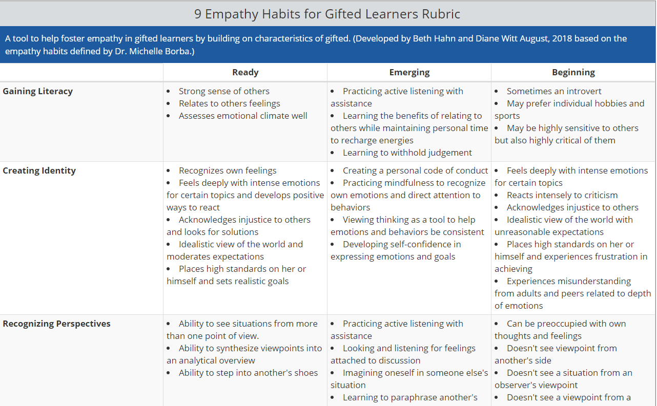
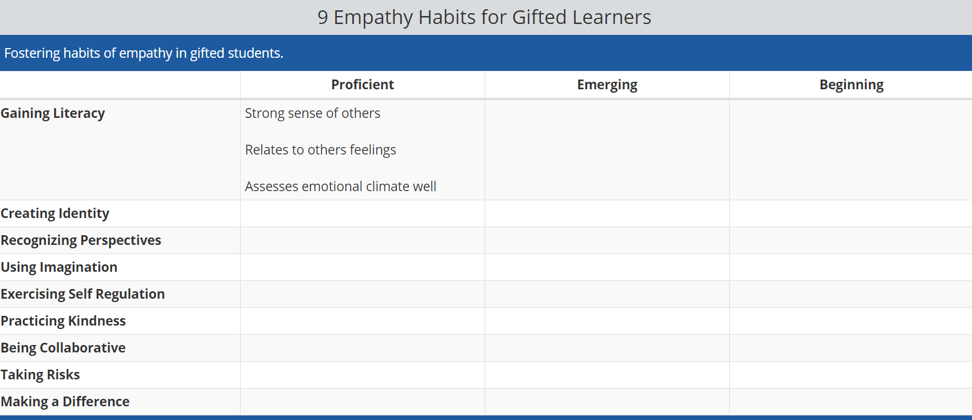
Notes:
A rubric developed to help teachers gauge a student’s progress toward practicing the 9 empathy habits. The “Beginning” and “Ready” columns focus more on student characteristics, while the “Emerging” column looks at skills to help students develop empathy habits.

Slide 28
I Practice Using the 9 Empathy Habits.
Literacy
Identity
Perspectives
Imagination
Self Regulation
Kindness
CollaborationI
Risk Taking
Make a Difference
My name is:
©2018
Notes:
Developing empathy skills is a little like practicing yoga. You have to do it every day and grow more flexible and balanced each day. Students may use self-reflection to gauge their own progress in using empathy habits.

Slide 29
________ practices using the 9 Empathy Habits.
Literacy
Identity
Perspectives
Imagination
Self Regulation
Kindness
Risk Taking
Make a Difference
©2018
Notes:
Developing empathy skills is a little like practicing yoga. You have to do it every day and grow more flexible and balanced each day. Students may use self-reflection to gauge their own progress in using empathy habits.

Slide 30
Rubric for 9 Empathy Habits for Gifted
Identity
Perspectives
Imagination
Self Regulation
Kindness
Risk Taking
Make a Difference
Name:
©2018
Notes:
Developing empathy skills is a little like practicing yoga. You have to do it every day and grow more flexible and balanced each day. Teachers
may use observation tools to reflect on student progress in using empathy habits.

Slide 31
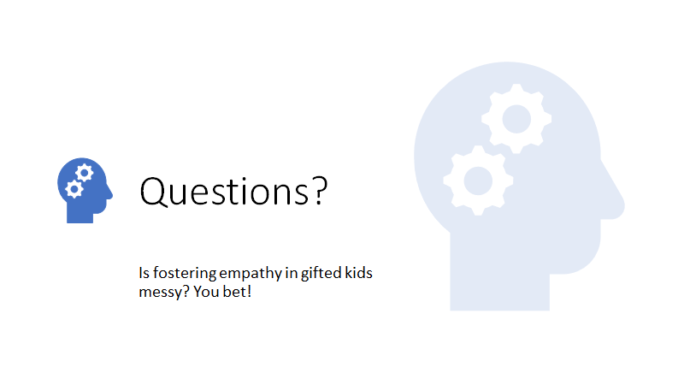
Notes:
But well worth the challenge!

Slide 32
For more information:
ebhahn18@gmail.com
deewitt@aol.com
quallsk@ucmail.uc.edu
Or see us on Facebook:
https://www.facebook.com/ebhahn18/

Slide 33
Resources
Borba, M.(2016). Unselfie: Why empathetic kids succeed in our all-about-me world. New York: Touchstone.
Casper, K. (Jan 26, 2017) Danger in a Can: Why Canned Social-Emotional Skill Programs in Schools Can Harm Gifted Students More Than Help Them. SENG Newsletter. Retrieved from https://docs.google.com/document/d/1EHXq1KM71BT36V7nUH4QWjnepres82Xam_ZVqs234VY/edit
Common Characteristics for Gifted Children. National Association for Gifted Children Website. Retrieved from https://www.nagc.org/resources-publications/resources/my-child-gifted/common-characteristics-gifted-individuals

